Slide 1


Workplace Pensions

Slide 2

Agenda
Introductions
Workplace Pensions
What goes in
How it’s managed
Salary exchange
What happens next
Questions

Slide 3


Slide 4


Workplace Pension
Managed by Prudential
Part of the M&G plc with assets of £370bn
Annual charge of 0.50%
No charges for transfer or payout on death
Over 40 funds to choose from

Slide 5

Workplace Pension
Administered by USS
Benefits are part Retirement Income (DB)/ part Investment Builder (DC)
Annual charge linked to investment
No charges for transfer or payout on death (Investment Builder section)
12 funds to choose from

Slide 6


Workplace Pension
What goes in
How it’s managed
Salary exchange

Slide 7
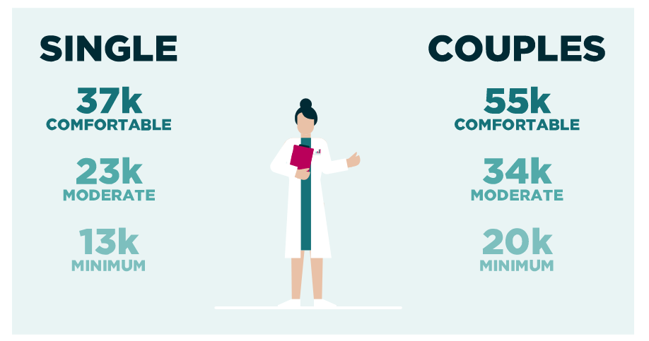
Retirement Living Standards
https://www.retirementlivingstandards.org.uk/

Slide 8
Retirement Living Standards
£10,600
?
?
Pensions are just part of the plan
Pension dashboard is coming
Order your State Pension forecast

Slide 9
What goes in
Clare College
You

Slide 10
Retirement Options
Pension Pot
25% Tax Free Lump Sum*
75% to provide taxable retirement income/
lump sum **
Access from age 55 (57 from 2028)
* Other options available with USS
** Available via Investment Builder with USS

Slide 11
Workplace Pension
What goes in
How it’s managed
Salary exchange

Slide 12
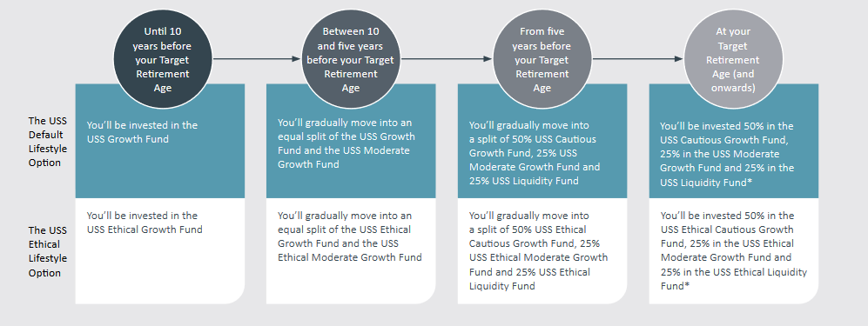
Lifestyle Strategy

Slide 13
Lifestyle Strategy

Slide 14
Dynamic Growth IV

Slide 15
Dynamic Growth II

Slide 16
Dynamic Growth IV

Slide 17
Dynamic Growth II

Slide 18
Investment Pathways
I have no plan to touch my money in the next five years – This aims for long-term, risk-controlled growth with a broad range of assets.
I plan to use my money to set up a guaranteed income (annuity) within the next five years – This aims to preserve your annuity-buying power.
I plan to start taking my money as long-term income in the next five years – This aims for capital growth with a long-term income target.
I plan to take out all my money in the next five years – This aims to preserve the value of your capital.
Question asked at aged 55

Slide 19
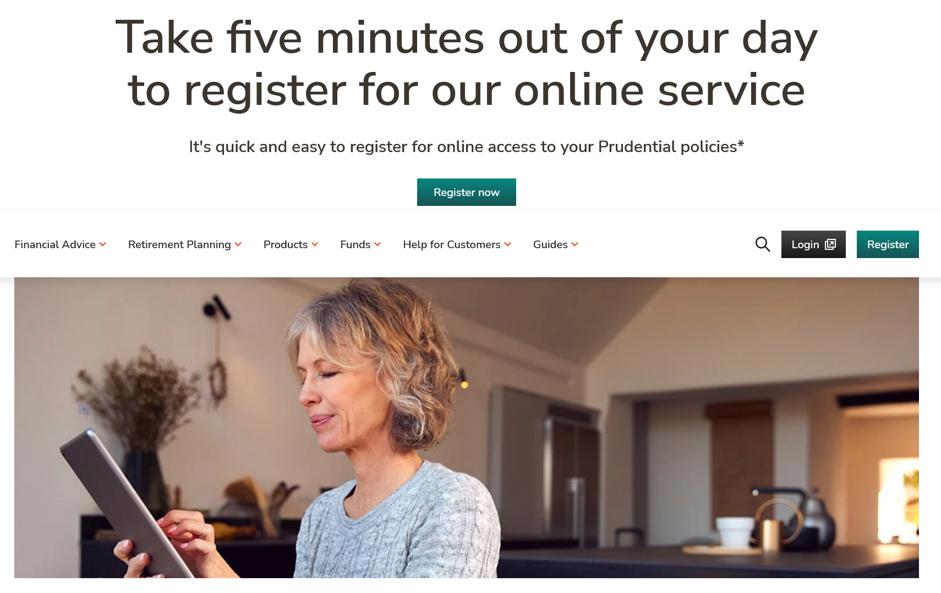
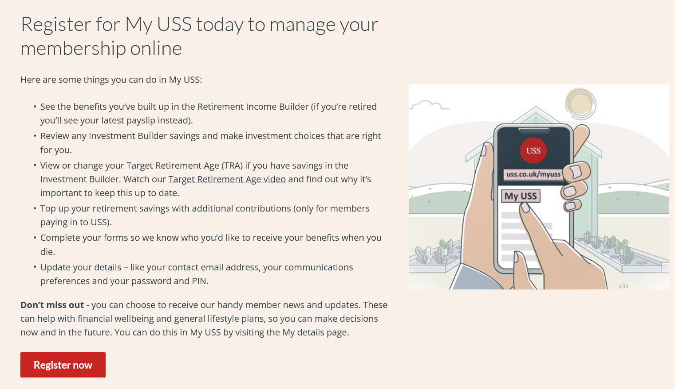
Online access

Slide 20
Workplace Pension
What goes in
How it’s managed
Salary exchange

Slide 21
What is it?
Salary exchange involves employees agreeing to change their terms and conditions of employment relating to pay. Under their revised contracts, employees give up some of their salaries in return for non-cash benefits from the employer – in this instance, employer pension contributions.

Slide 22
Myth busters
Frowned on by HMRC
Can affect benefits
Lower mortgage offer
In 2017 HMRC confirmed happy with salary exchange for;
Pensions
Advice
Ultra low emission vehicles
Workplace nurseries
Cycle to work
Benefits calculated on pre-exchange salary
Clare College providers have amended their scheme rules
Salary exchange improves take home pay
Affordability checks
State pre-exchange salary with explanation

Slide 23
How it works
 | Before Salary Exchange | After Salary Exchange
Gross Salary | £21,500.00 | £20,855.00
Income Tax | £1,786.00 | £1,657.00
NI Contributions | £1,071.60 | £994.20
Annual Pension Contribution (net) | £516.00 | 0
Net Pay | £18,126.40 | £18,203.80
3% pension contribution
Full personal allowance
 | Before Salary Exchange | After Salary Exchange
Your Pension Contribution | £645.00 | 0.00
College Pension Contribution | £1,290.00 | £1,935.00
Pension Contribution | £1,935.00 | £1,935.00

Slide 24
How it works
 | Before Salary Exchange | After Salary Exchange
Gross Salary | £21,500.00 | £19,995.00
Income Tax | £1,786.00 | £1,485.00
NI Contributions | £1,071.60 | £891.00
Annual Pension Contribution (net) | £1,204.00 | 0
Net Pay | £17,438.40 | £17,619.00
7% pension contribution
Full personal allowance
 | Before Salary Exchange | After Salary Exchange
Your Pension Contribution | £1,505.00 | 0.00
College Pension Contribution | £3,010.00 | £4,515.00
Pension Contribution | £4,515.00 | £4,515.00

Slide 25
Things to remember
Good time to review your contribution level
Can change again in the future (subject to minima)
Annual changes only except for ‘life events’
Care if your hourly rate is £11 or below
Be careful with large amounts – can impact National Minimum Wage rules and State Benefits
Higher rate taxpayers in Prudential should tell HMRC about move to salary exchange

Slide 26
What happens next
Take salary exchange documentation
Return to Sally Hewings, HR Manager by 8 March
April payroll first deduction on salary exchange basis

Slide 27



Useful Links
https://login.pru.co.uk/Login/dialog/customer/Registration/PolicyType
https://www.uss.co.uk/register-for-my-uss
https://www.gov.uk/check-state-pension
https://www.pensiontracingservice.com/
https://www.moneyhelper.org.uk/en

Slide 28






Photo Collage
Get a State pension forecast
Register online with
your pension
Sign up for
salary exchange
Pretend you are 55 and pick a pathway

Slide 29
Questions
Sally Hewings
sh435@clare.cam.ac.uk
01223 333222
Glen Campbell
gcampbell@dartingtonbenefits.com
07720 287983

Slide 30
Regulatory Statement
The information contained within this presentation does not constitute financial advice
The information provided is based on our understanding of current law and taxation as at February 2023
HMRC policy, practice and legislation may change in the future
Dartington Employee Benefits is a trading style of Dartington Wealth Management Ltd and is authorised and regulated by the Financial Conduct Authority

